Slide 1

Data Analysis And Predictive Modelling For Llyod World Risk Poll
-
Submitted to
Proff. Devlina Chatterjee
Abhinav Pratap Singh(231140001)
Aditya Kumar(231130002)
Aman Ingle(231140003)
Samyak Srivatsa(231140020)
Yash Mishra(231140026)

Slide 2
Contents
Dataset Overview
Objectives
Feature selection
Exploratory Data Analysis
Least Square Assumptions
Predictive Modelling
Hypothesis Testing

Slide 3
Dataset Overview
The 2021 Lloyd’s Register Foundation World Risk Poll is the second wave of data collection and analyses of people’s attitudes, experiences and behaviors with respect to various aspects of risk and safety. The global survey was conducted against the backdrop of the Covid-19 pandemic and focused in part on how risk-related experiences and perceptions have shifted since the 2019 World Risk Poll.
About the survey :As in 2019, the 2021 World Risk Poll was included as a module within the Gallup World Poll. Since 2005, the Gallup World Poll has regularly surveyed residents in more than 140 countries, areas and territories using randomly selected, nationally representative samples that represent, in most years, more than 98% of the world’s aged 15-years-or-older population.

Slide 4

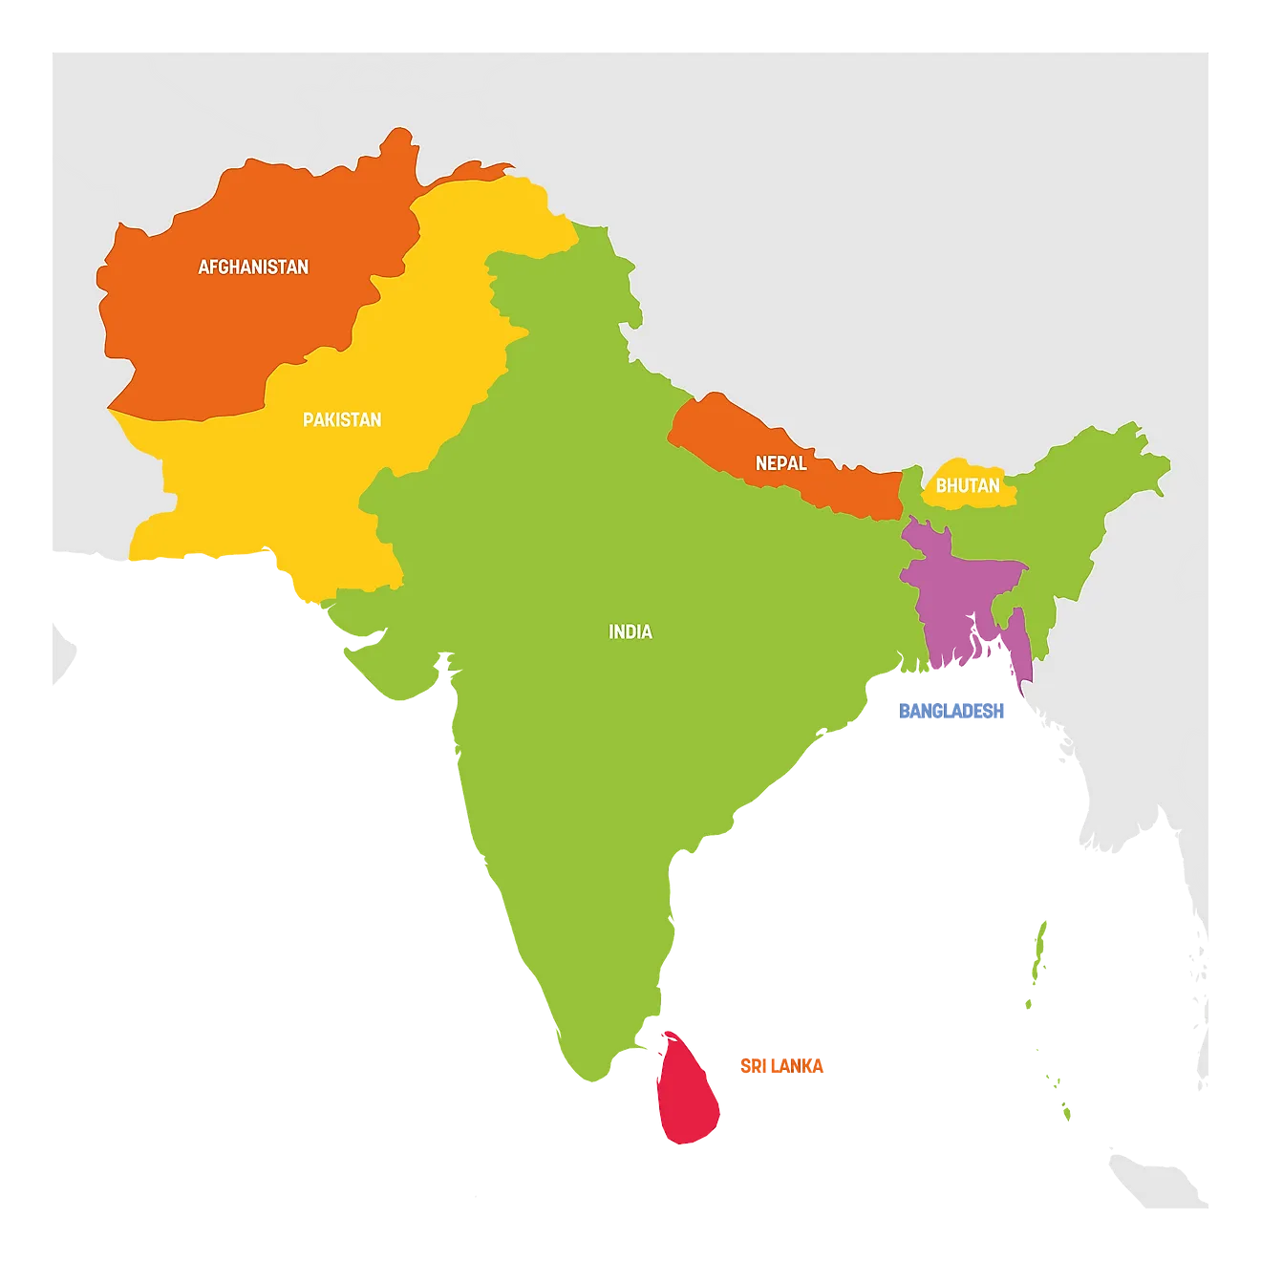
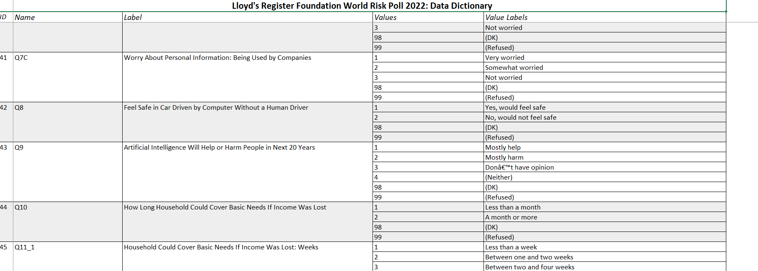
Dataset Overview
The dataset consisted of data from 143 countries divided into 15 regions according to their geographical location.
A total of 70+ Questions were asked to 280k residents of these countries across the world.
Questions asked in survey.
Resilence Index
We considered the data of Region 10 for the year 2021 for our analysis as we have the most contextual and behavioural understading for the same.
Independent Variables-
Measure of the capacity of individuals, communities, and systems to survive, adapt, and grow in the face of stress and shocks, and even transform, when conditions require it .
Dependent Variables-

Slide 5
Objectives
Analyzing Global Trends Impacting Resilience Indices Across Diverse Nations.
Utilizing Linear Regression for Predictive Modeling.
Comparative Analysis of Higher-Order Models Versus Linear Models for Enhanced Dataset Modeling.

Slide 6
Feature Selection
Columns with null values exceeding 50% were systematically removed from the dataset.
Furthermore, columns exhibiting a correlation coefficient (r) with the dependent variable below 5% were thoughtfully eliminated.
In addition, a meticulous review of the dataset led to the removal of certain columns based on contextual understanding and relevance.
Redundant features were also meticulously identified and subsequently excluded from the dataset.
Null Values
Correlation
Feature Selection
Context
Redundancy

Slide 7
Feature Selection
Feature | Question asked
Urbanicity | Urban/rural -- recoded into 2 groups
Q4E | Worried Traffic or Roadside Accident Could Cause Serious Harm
Age | Age
Q1 | Feel More, Less or About as Safe Compared With Five Years Ago
Q9 | Artificial Intelligence Will Help or Harm People in Next 20 Years
Q4F | Worried Mental Health Issues Could Cause Serious Harm
EMP_2010 | Employment Status
Q4C | Worried Violent Crime Could cause serious harm
Gender | Gender
HouseholdSize | Total number of people in household
Q10Q11Recode | how long would you be abl to cover your basic needs
ChildrenInHouseHold | Children under 15 in the household
Q6 | Used Internet, Including Social Media, in Past 30 Days
CountryIncomeLevel2021 | World Bank Country Income Classification corresponding to 2021 data
IncomeFeeling | Feelings About Household Income
Education | Education Level
Feature | Correlation (r) with dependent variable | Type of Encoding
Urbanicity | 0.019438 | One Hot
Q4E | 0.025087 | Ordinal
Age | 0.066773 | Ordinal
Q1 | 0.086451 | Ordinal
Q9 | 0.096583 | One Hot
Q4F | 0.102080 | Ordinal
EMP_2010 | 0.136254 | One Hot
Q4C | 0.139095 | Ordinal
Gender | 0.143974 | One Hot
HouseholdSize | 0.221710 | One Hot
Q10Q11Recode | 0.253197 | One Hot
ChildrenInHouseHold | 0.271989 | One Hot
Q6 | 0.331593 | One Hot
CountryIncomeLevel2021 | 0.364206 | Ordinal
IncomeFeeling | 0.371784 | Ordinal
Education | 0.438818 | Ordinal

Slide 8
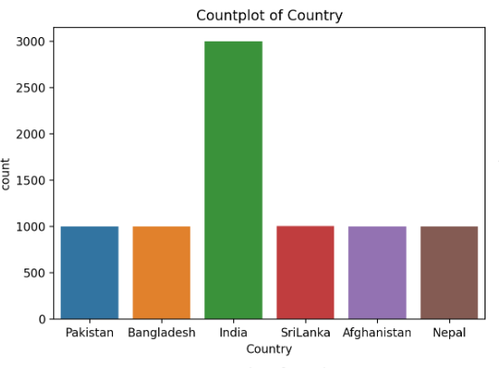
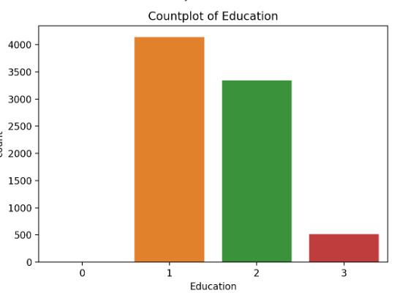
Exploratory Data Analysis
Exploratory Data Analysis refers to the critical process of performing initial investigations on data so as to discover patterns , to spot anomalies , to test hypothesis and to check assumptions with the help of summary statistics and graphical representations.

Slide 9
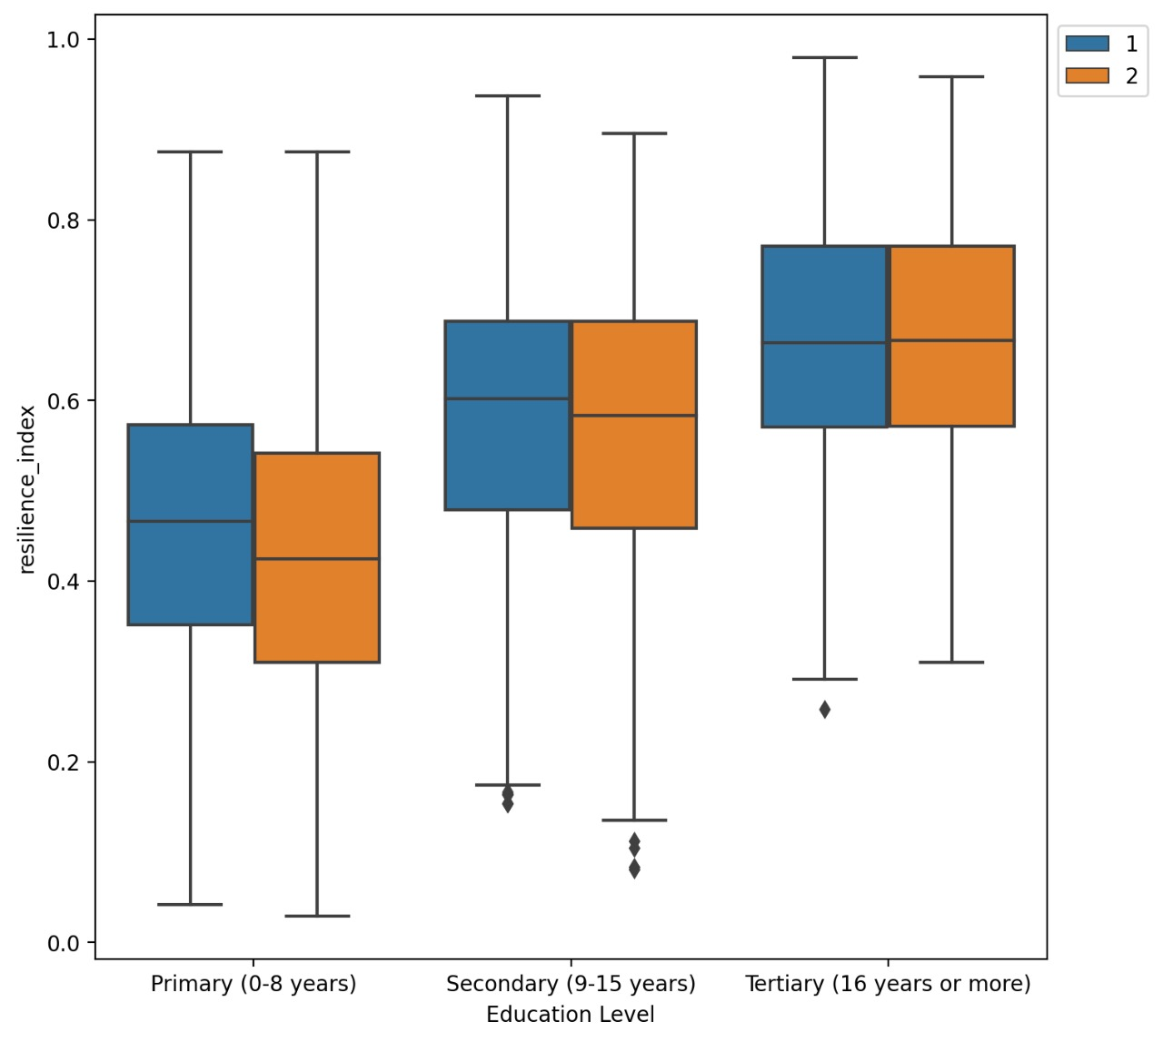
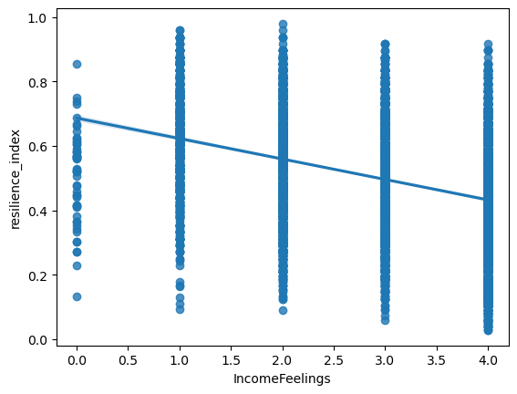
Exploratory Data Analysis

Slide 10
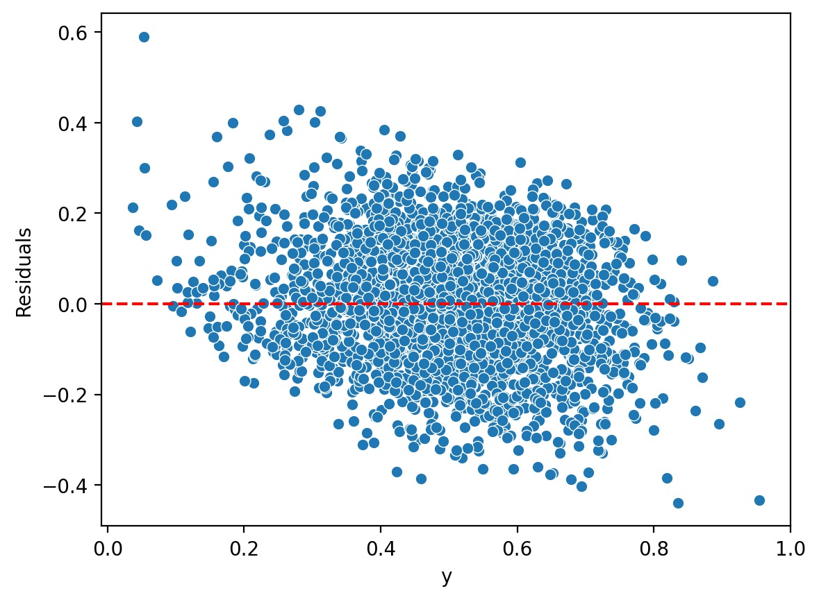
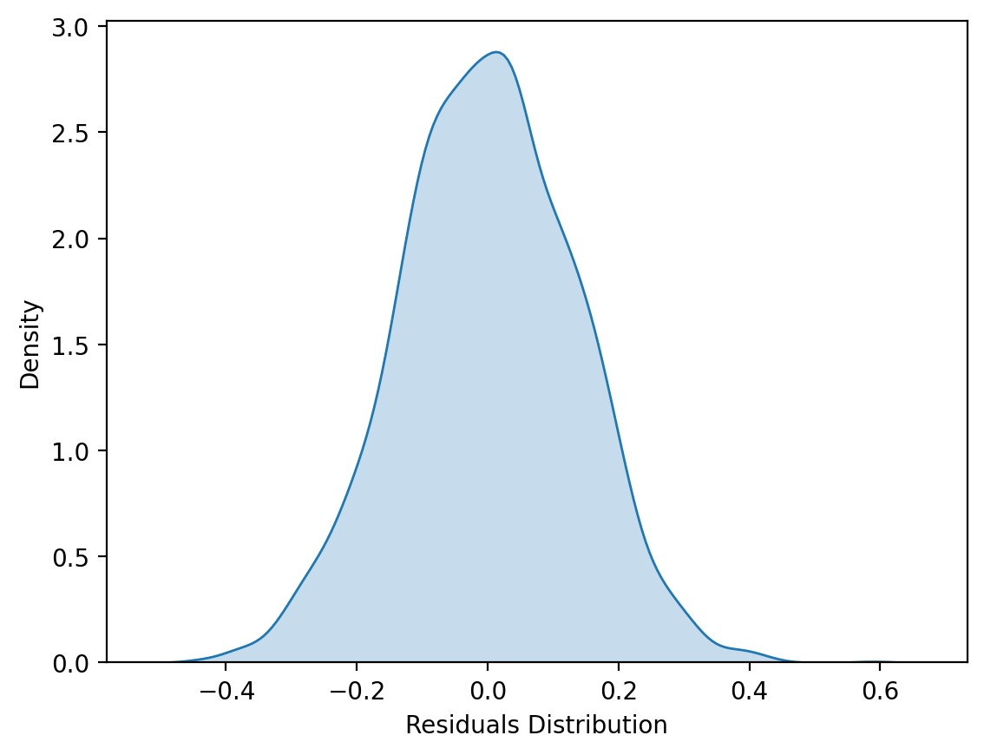
Least Squares Assumptions
The conditional distribution of u given X has mean zero, that is, E(u|X = x) = 0.

Slide 11
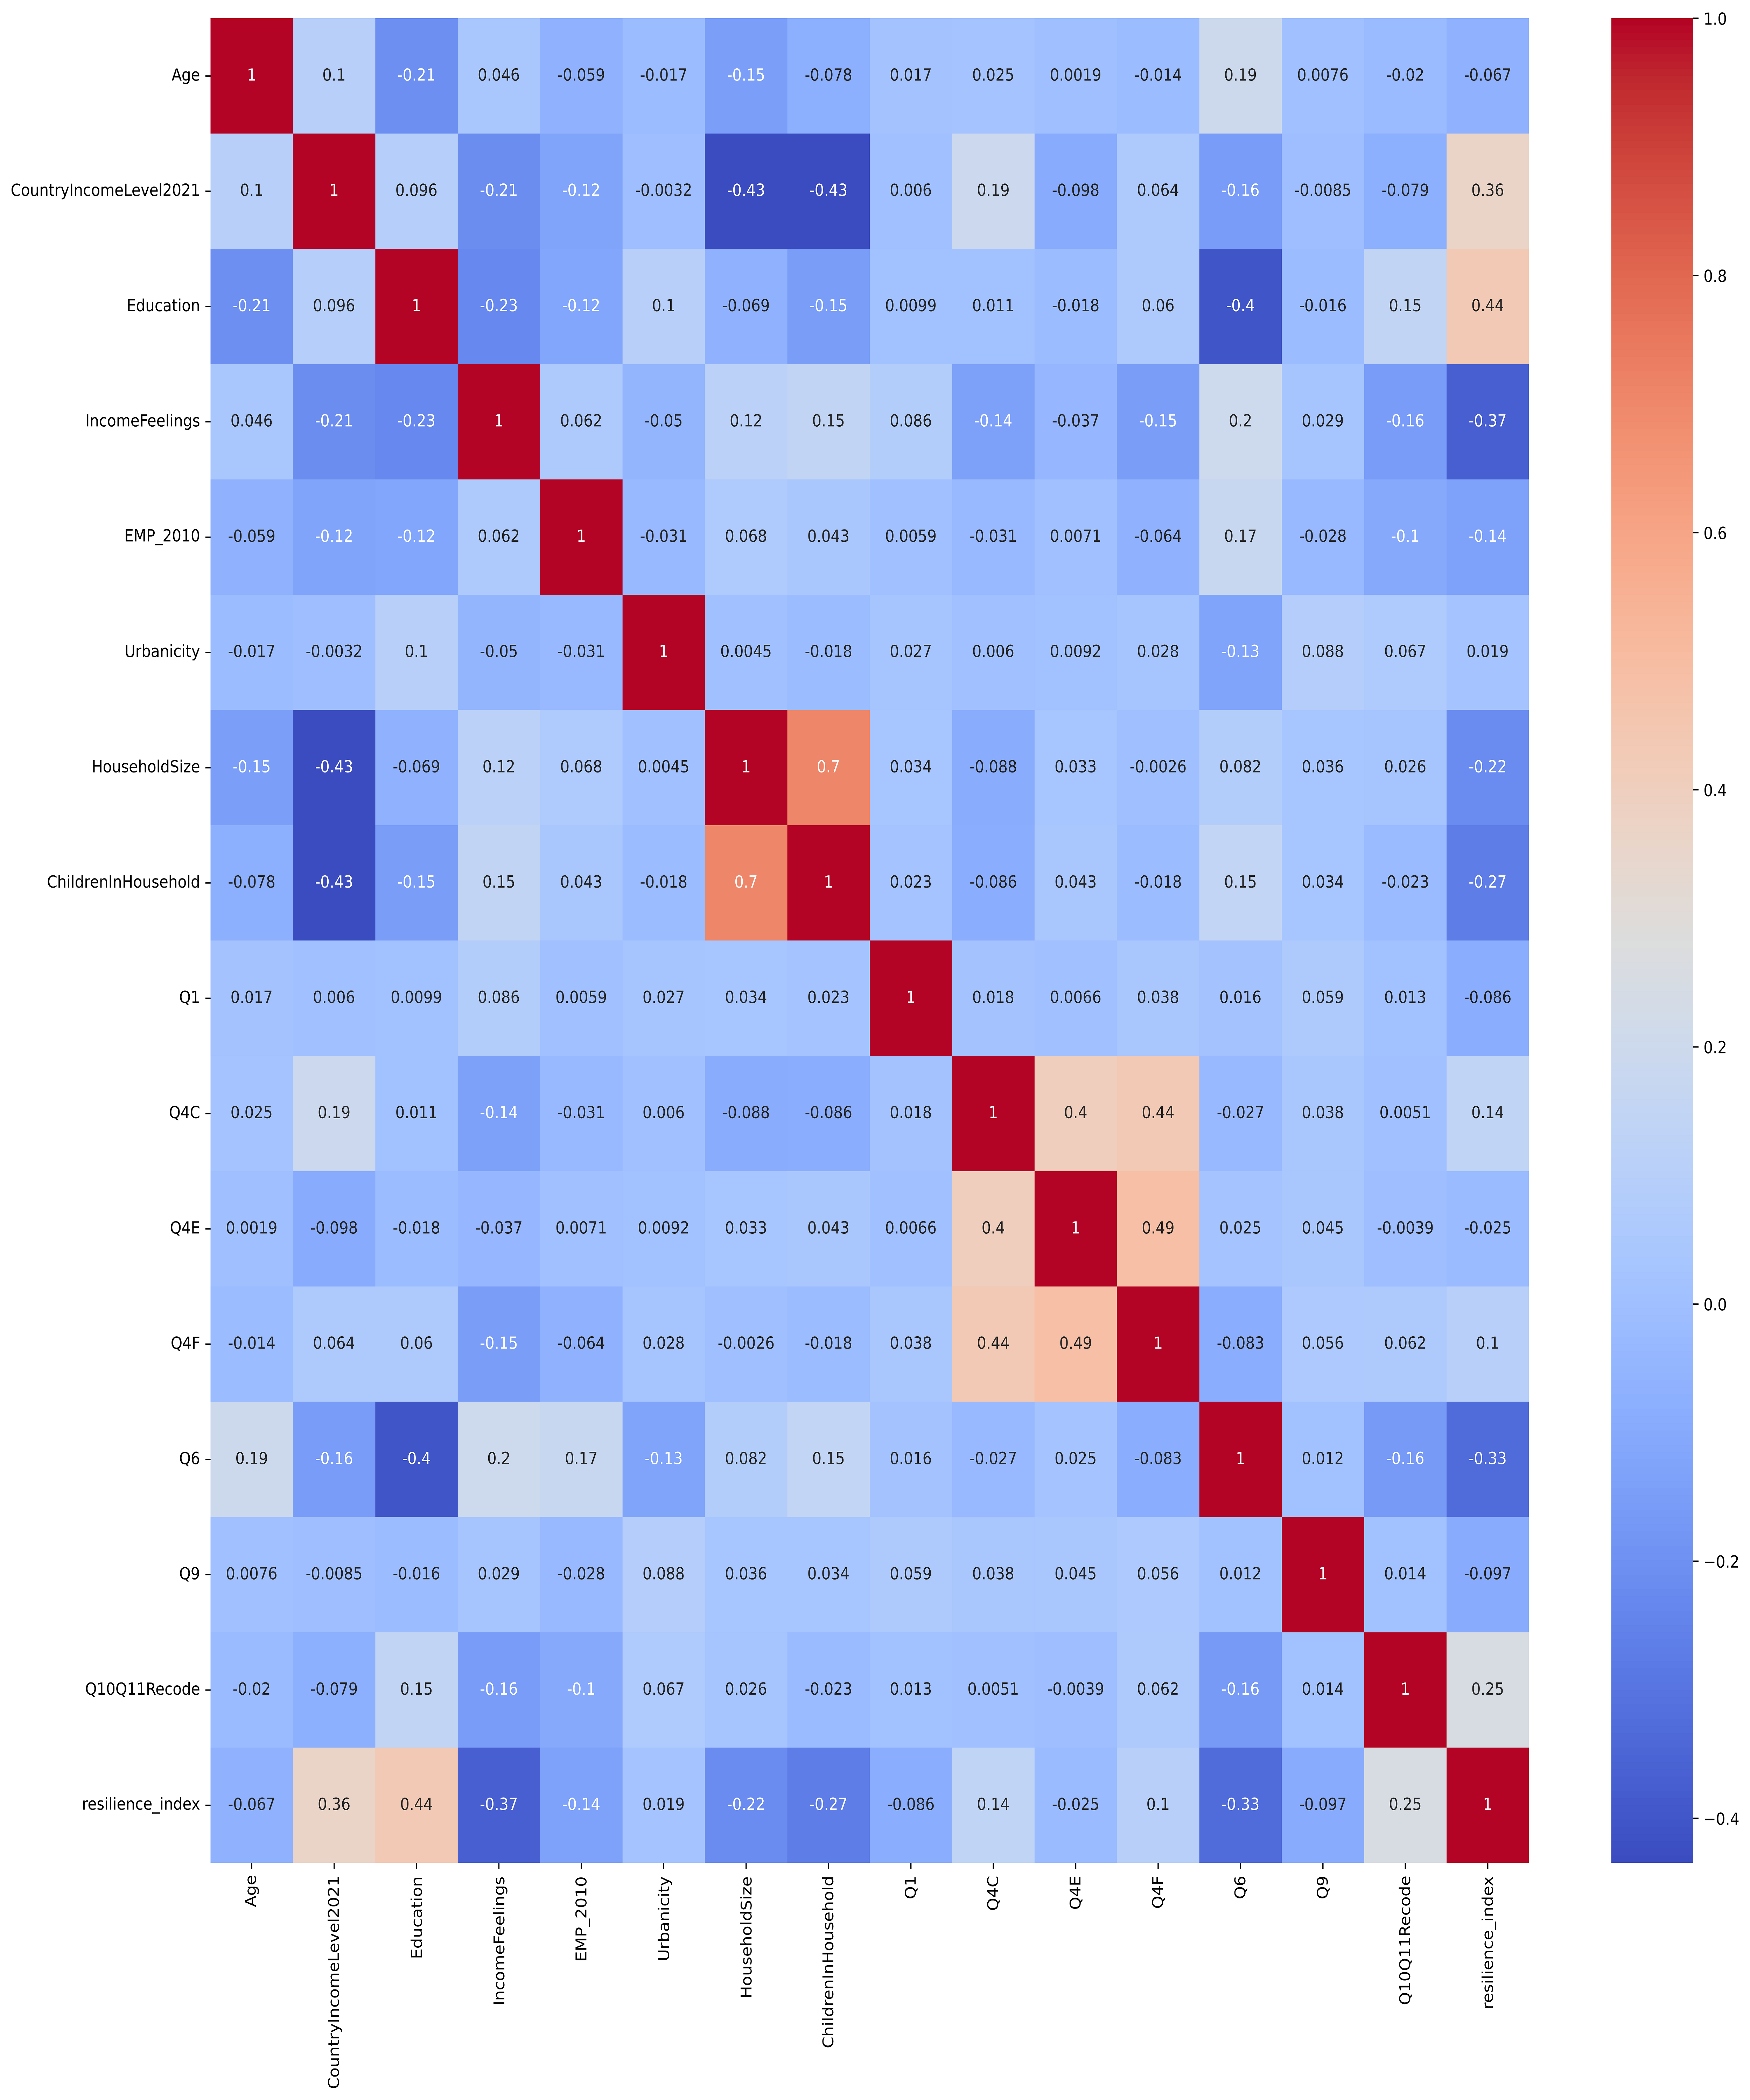
Least Squares Assumptions
(X_{i} ,Y_{i}), i =1,…,n, are i.i.d.
The sampling was random and same types of questions were asked to the population sample. Hence, we can approximate the distribution as i.i.d.
Large outliers in X and/or Y are rare.
Most of the data was categorical and presence of outliers were negligible.
There is no perfect multicollinearity.
This assumption was checked using the correlation matrix.

Slide 12
Predictive Modelling
We would be using Linear regression to model the effect of 17 independent variables on our dependent variable i.e. resilience index.
For the loss/cost function we would be using ordinary least squares.
We would then explore the possibility of higher order regression model and compare it with the Linear model.

Slide 13
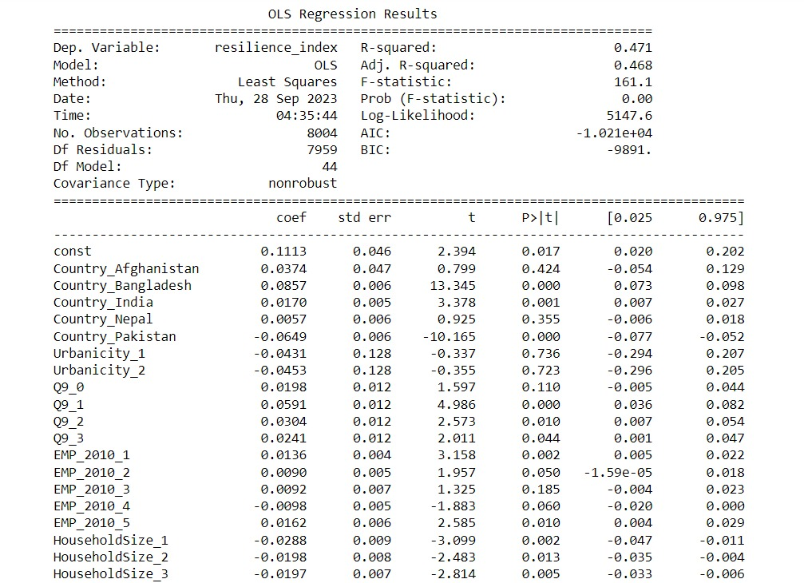
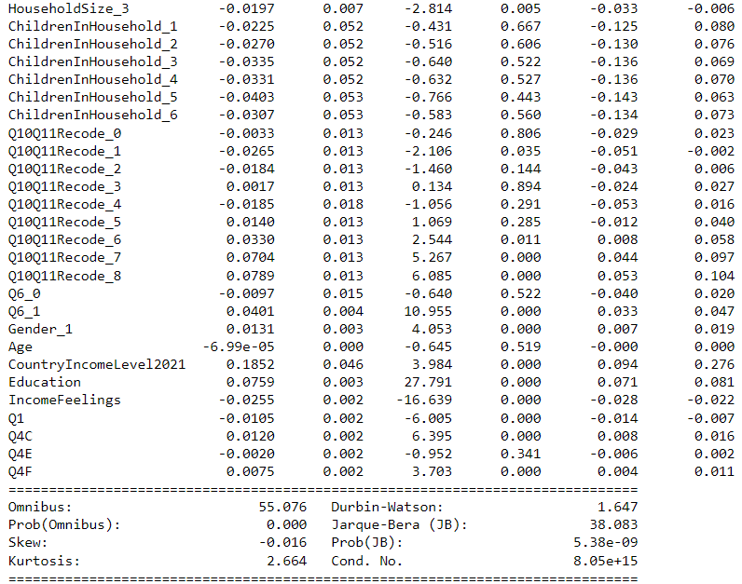
Predictive Modelling: OLS Regression

Slide 14
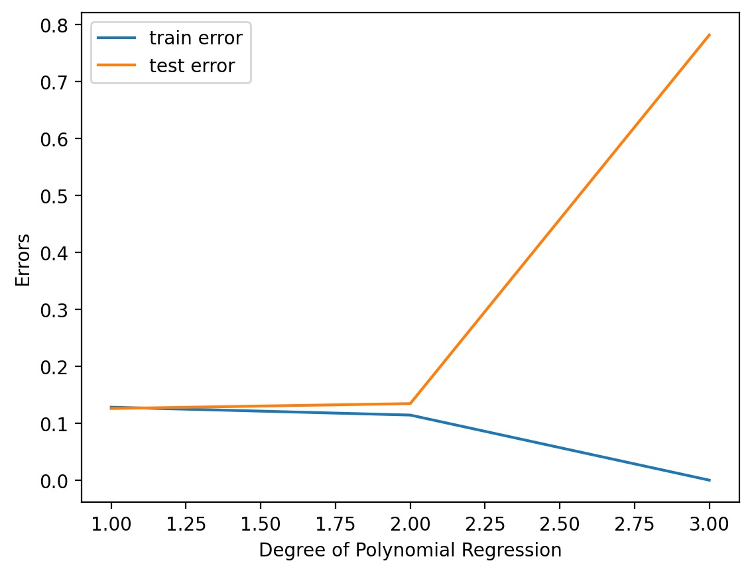
Linear vs Polynomial Regression
As we increase the degree of polynomial we observe that the model gets better on training data but there is a sharp increase in test error beyond the second degree of polynomial.
R2 decreased to 0.40 (for polynomial degree 2) from earlier value of 0.471.

Slide 15
Regularization
Minimize Model Complexity.
Penalizing the Loss Function.
Reducing Model Overfitting.
After Hyperparameter Tuning , we achieved R2 score of 0.478 from the initial score of 0.471.
L1 Regularization
L2 Regularization
Elastic net (combination of L1 & L2 Regularization)
Why do we use Regularization?

Slide 16
Conclusion
Polynomial regression is not a better fit for our data as the on increasing order of the polynomial error is increasing.
OLS regression gives better fit than the Polynomial.
By using L1 regularization we can increase the accuracy of our model.

Slide 17
THANK YOU

